Slide 1

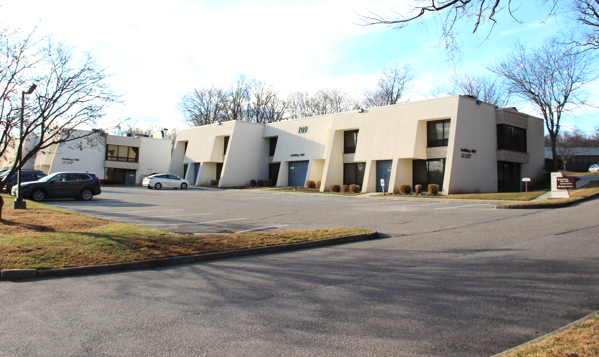
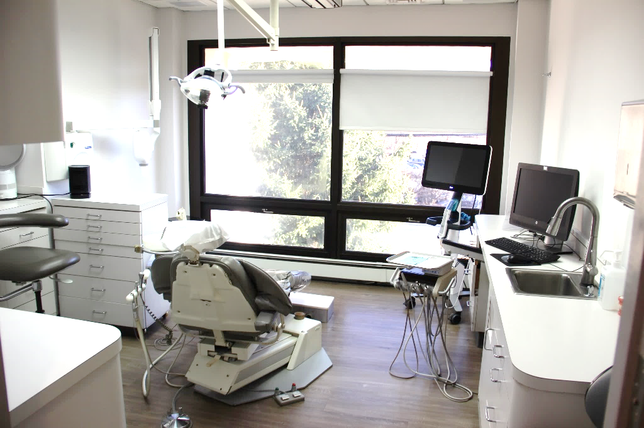


FOR SALE: Mount Kisco Office/Medical Condominium on Busy South Bedford Road
FULLY BUILT-OUT MODERN DENTAL OFFICE
101 S. Bedford Rd, Mount Kisco, NY 10549
Excellent Location Near Numerous Medical Practices, CareMount Medical Group, Northern Westchester Hospital and Downtown Mount Kisco
2,500 SF Total
Divisible Variations
550 SF, 850, SF, 1,100 SF
INQUIRE FOR PURCHASE PRICE
CONTACT OWNER’S
EXCLUSIVE AGENT:
ALEC FREDERICO: 914-779-8200 x118 alec@admiralrealestate.com
BROKERS
PROTECTED
ADMIRAL REAL ESTATE SERVICES CORP. | 62 Pondfield Rd Bronxville, NY 10708 | Jonathan H. Gordon, Corporate Broker | admiralrealestate.com

Slide 2
SITE DETAILS & DEMOGRAPHICS
MOUNT KISCO, NY
101 S. Beford Road
SPACE DETAILS
2,500 SF Office condominium for sale
Available to divide to 550 SF, 850 SF, and 1,100 SF
Possibility for new owner/user to lease variations to tenants
(3) bathrooms – (1) is ADA, (3) entrances, (5) exam rooms with plumbing (w/ room for 2 more to be added) & kitchen facilities
Reception, waiting area, break room, and laboratory
Additional offices for private use or consultations
Windowed throughout with natural light and relaxing views
Ample on-site parking directly in front of unit
Currently built-out as fully operational dental suite
Recently renovated with modern design and fixtures
In proximity to Optum Multi-Specialty Group and Northern Westchester Hospital
Close to Metro North; minutes to I-684 & Saw Mill River Pkwy
NEW YORK’S
WESTCHESTER COUNTY
STRONG SPENDING POWER
$22.1 billion in Westchester
RETAIL DEMAND
KEY FACTS (15-Minute Drive-Time From Site)
POPULATION
70,715
AVG INCOME
$246,887
HOUSEHOLDS
23,839
DISPOSABLE INCOME
$134,219
DEMOGRAPHICS
NOV 2024 MOUNT KISCO MEDIANHOME SALES PRICE
$1,800,000
https://www.houlihanlawrence.com/community-mount-kisco

Slide 3
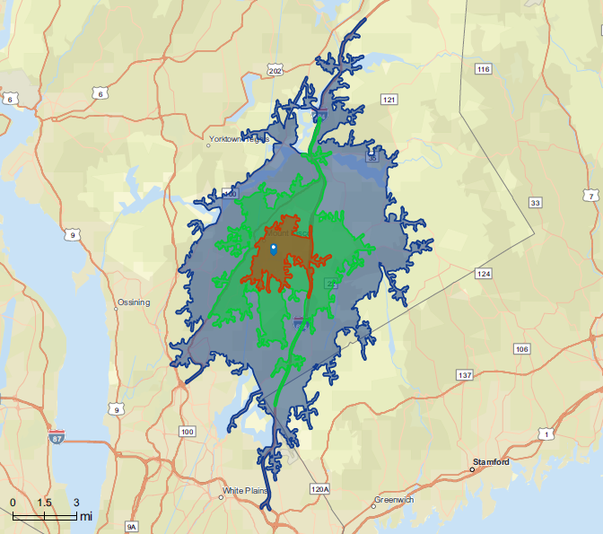
SITE MAP
MOUNT KISCO, NY
101 S. Beford Road
DRIVE-TIME:
5-MINUTES
10-MINUTES
15-MINUTES

Slide 4
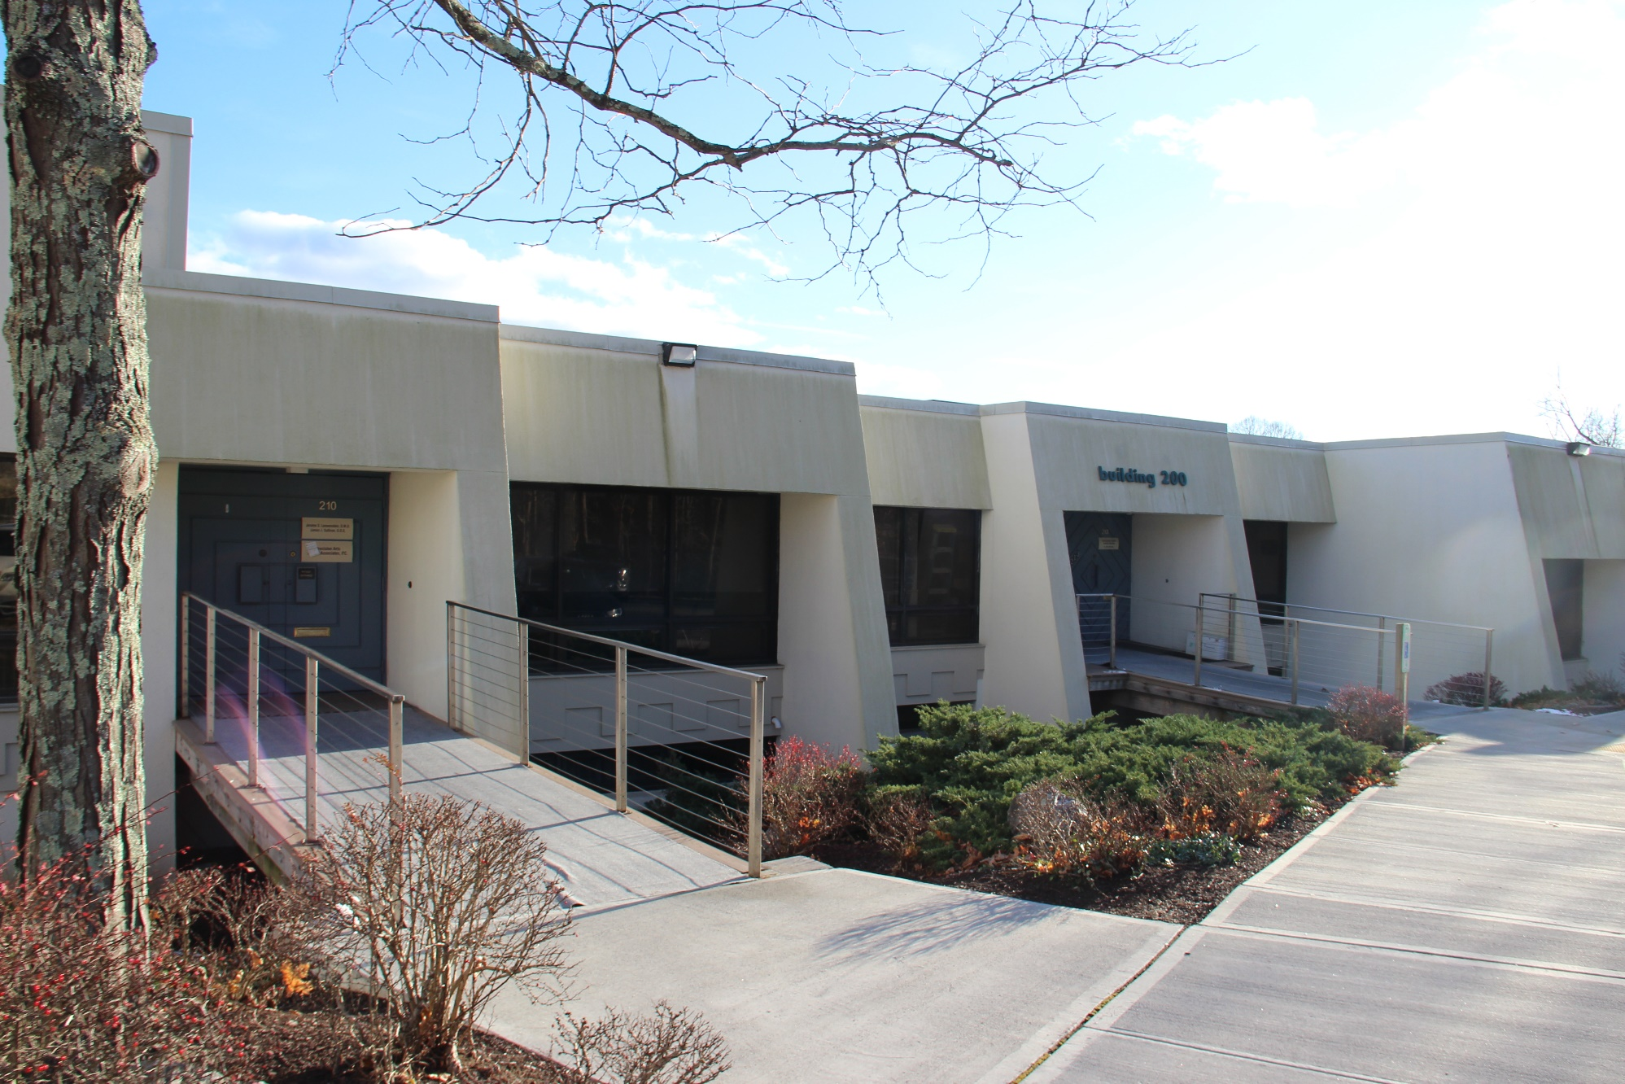
ADDITIONAL EXTERIOR PHOTO
MOUNT KISCO, NY
101 S. Beford Road

Slide 5
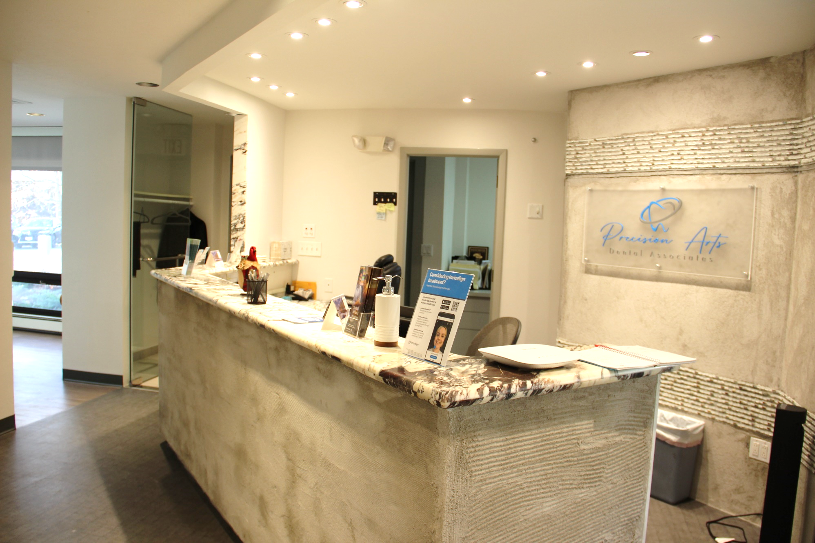
INTERIOR PHOTOS
MOUNT KISCO, NY
101 S. Beford Road

Slide 6
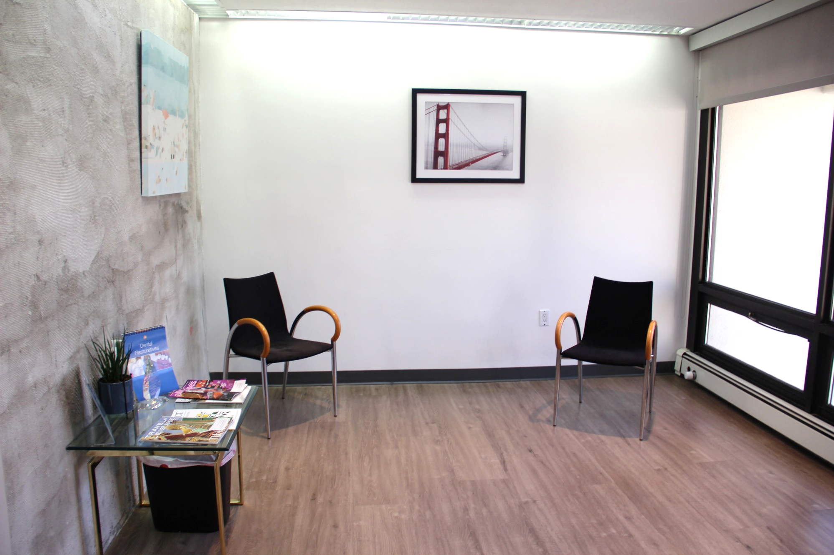
INTERIOR PHOTOS
MOUNT KISCO, NY
101 S. Beford Road

Slide 7
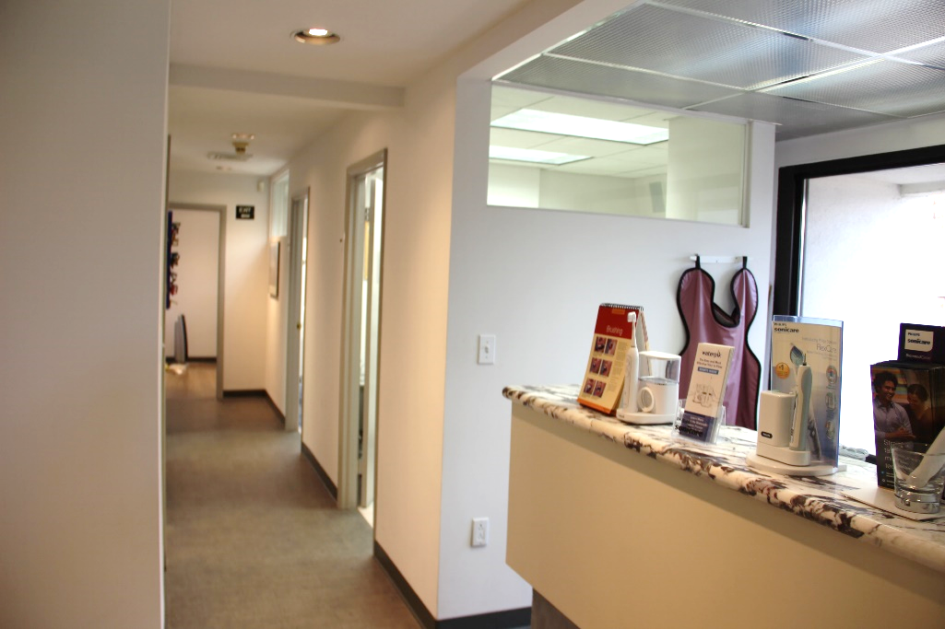
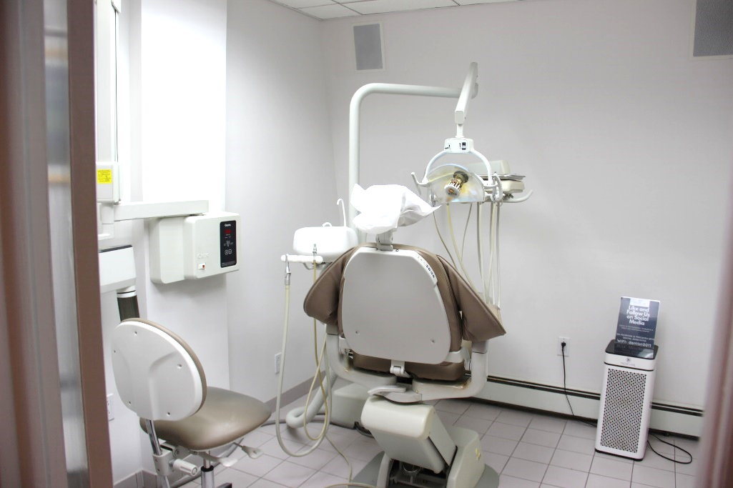
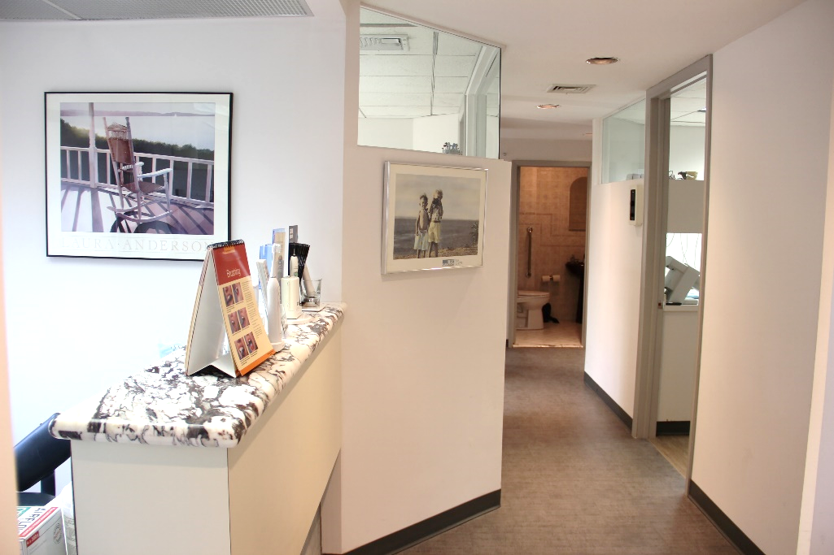
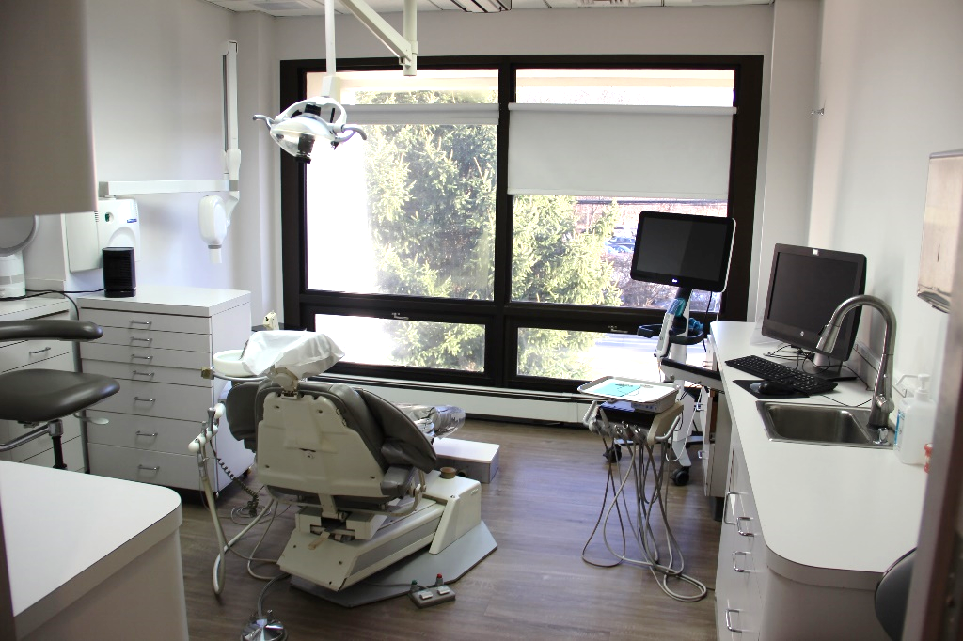
INTERIOR PHOTOS
MOUNT KISCO, NY
101 S. Beford Road

Slide 8
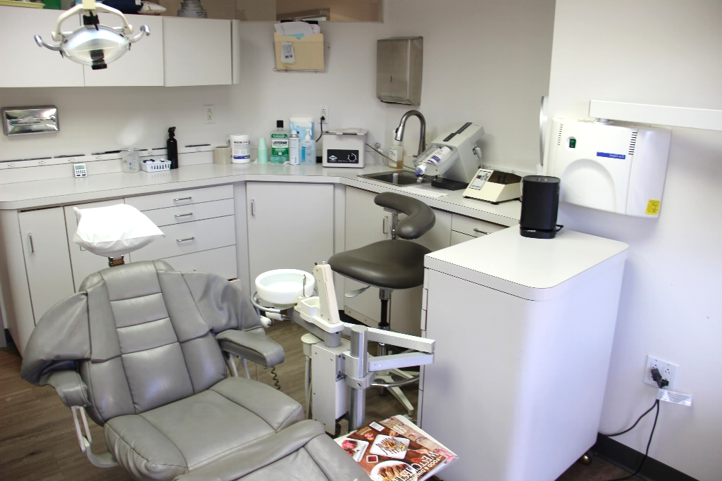
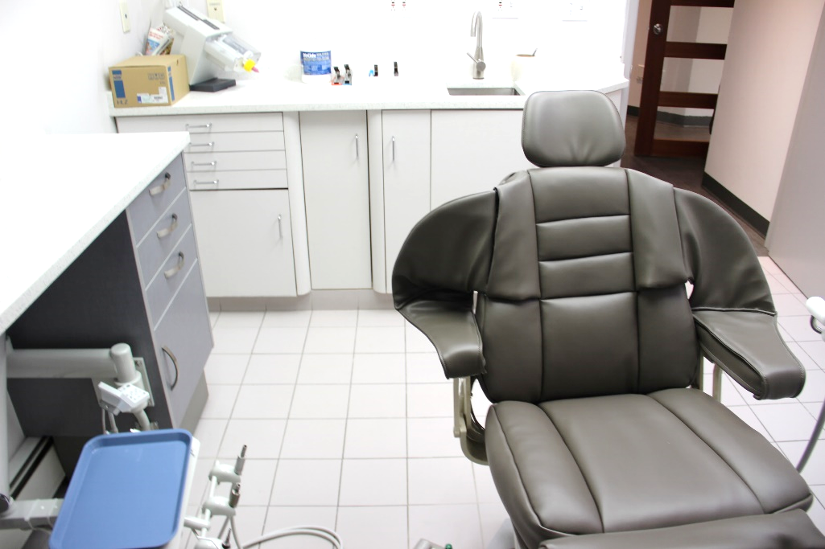
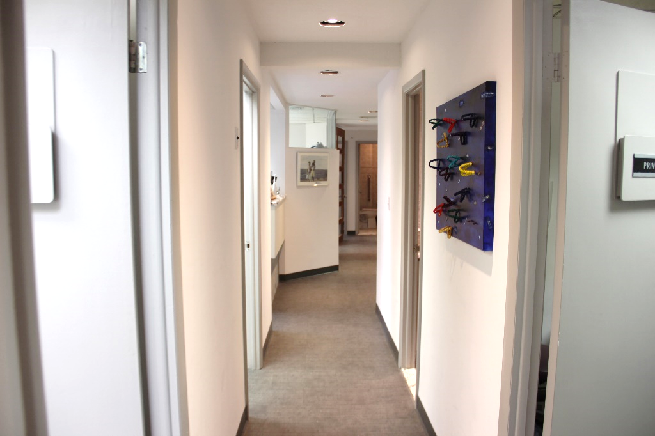
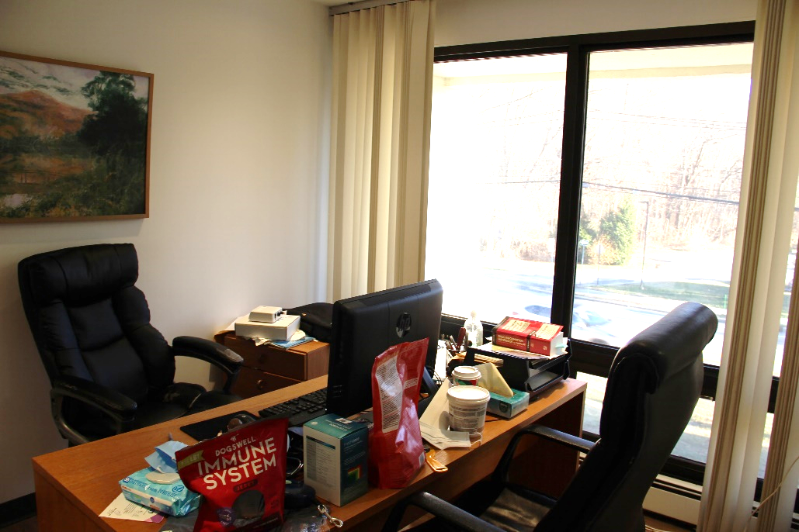
INTERIOR PHOTOS
MOUNT KISCO, NY
101 S. Beford Road

Slide 9
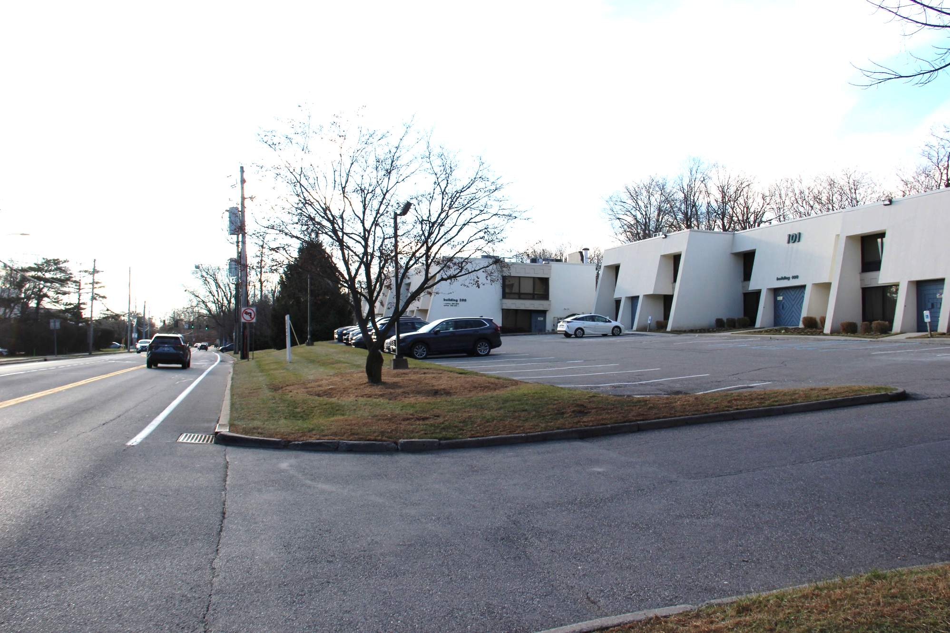
VISIBLITY
MOUNT KISCO, NY
101 S. Beford Road
SITE
SOUTH
BEDFORD
ROAD

Slide 10
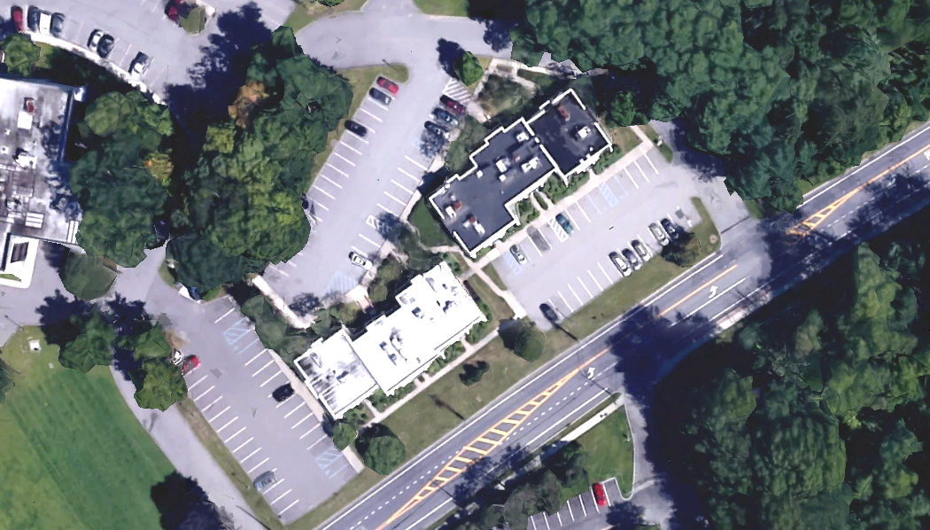
PARKING AERIAL
MOUNT KISCO, NY
101 S. Beford Road
SITE
S. BEDFORD RD

Slide 11
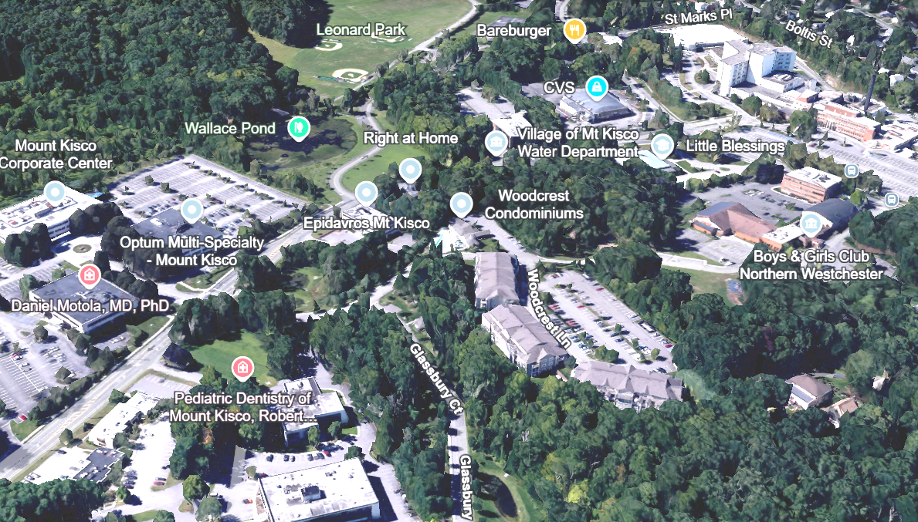


LOCAL AERIAL
MOUNT KISCO, NY
101 S. Beford Road
BEDFORD
HILLS
DOWNTOWN
MT. KISCO
S. BEDFORD RD
SITE

Slide 12
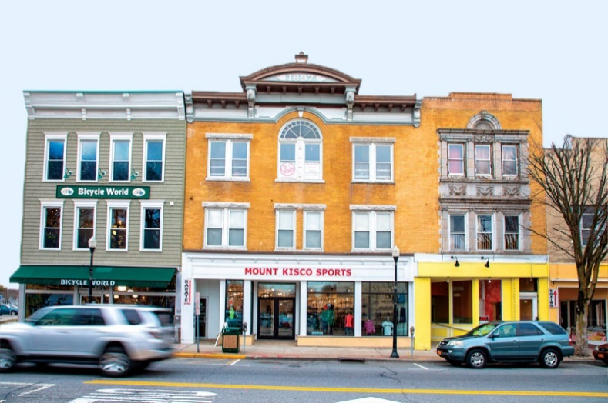
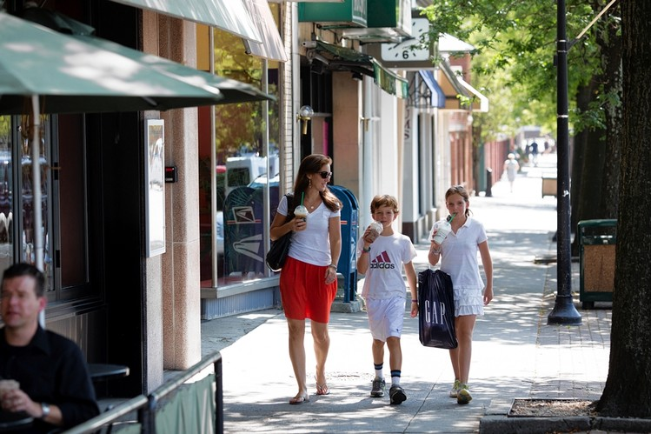
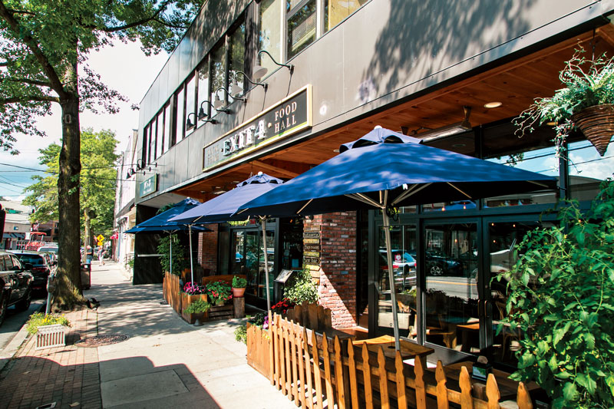
1 STONE PLACE | BRONXVILLE, NY
(AKA 30 MILBURN STREET)
MOUNT KISCO, NY
MOUNT KISCO, NY
101 S. Beford Road
MOUNT KISCO, NY | The Market
SMALL AREA, BIG VILLAGE
Only 43 miles north of Manhattan, Mount Kisco is one of Westchester’s most vibrant communities. Located centrally in Westchester at the confluence of multiple highways, Mount Kisco
is a retail destination which draws visitors from a wide area for its shopping, dining, entertainment and medical services. Often, people from surrounding towns and counties come to shop at the village's array of stores. It has been said that the population of the village doubles on key shopping days.
The village has a rich downtown tenancy including many national retailers and local favorites such as Barnes & Noble, HomeGoods, Gap, Chop’t, Chicos, Athleta, Starbucks, The Mount Kisco Theatre, Orangetheory, Frannie’s Goodie Shop, Exit 4 Food Hall, Village Social, and F45 Training, among others.
Due to its exceptionally commutable and accessible location by car or train, and its diverse businesses in a walkable downtown, Mount Kisco provides an urban feel in a spacious suburban environment.
Notes:
Summary of 2005 Demographics
1-Mile Radius
3-Mile Radius
5-Mile Radius
Average Household Income
$164,268
$137,088
$108,570
Median Household Income
$103,702
$97,128
$78,859
Population
15,630
109,659
349,829
Total Households
6,025
39,567
130,273
Pop. Density (per Sq. Mi.)
4,975
3,878
4,454
Summary of 2005 Demographics
1-Mile Radius
3-Mile Radius
5-Mile Radius
Average Household Income
$164,268
$137,088
$108,570
Median Household Income
$103,702
$97,128
$78,859
Population
15,630
109,659
349,829
Total Households
6,025
39,567
130,273
Pop. Density (per Sq. Mi.)
4,975
3,878
4,454

Slide 13
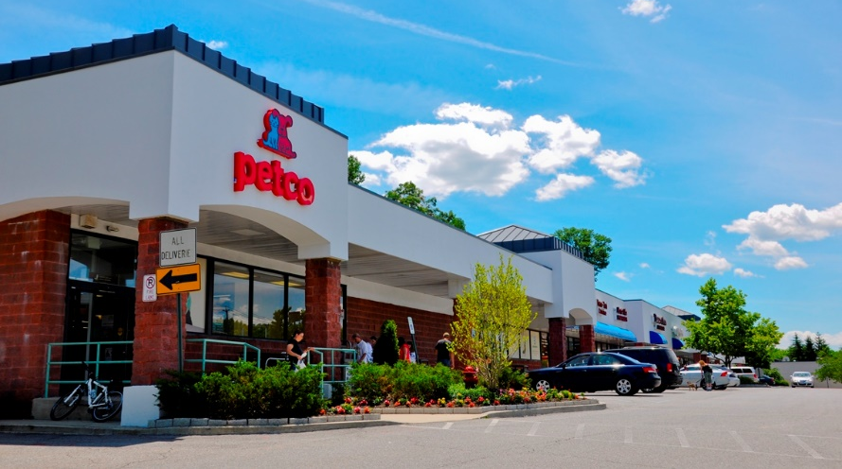
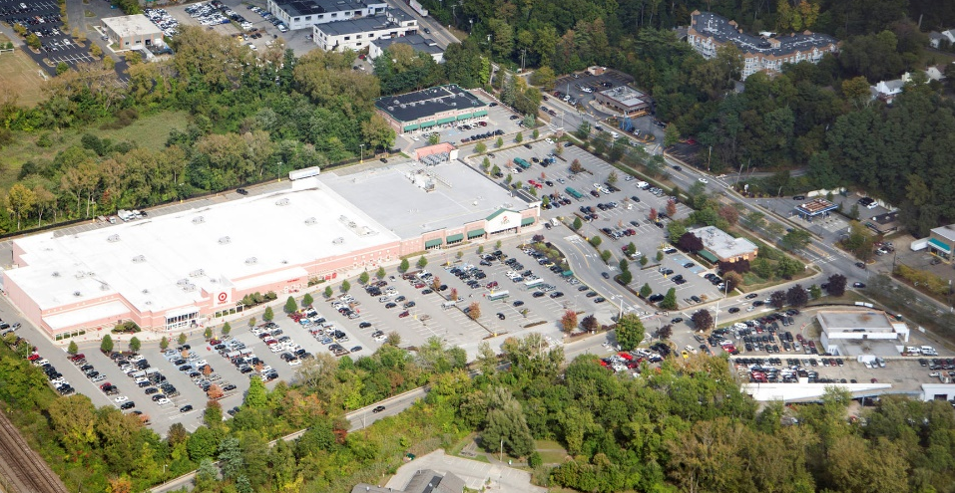
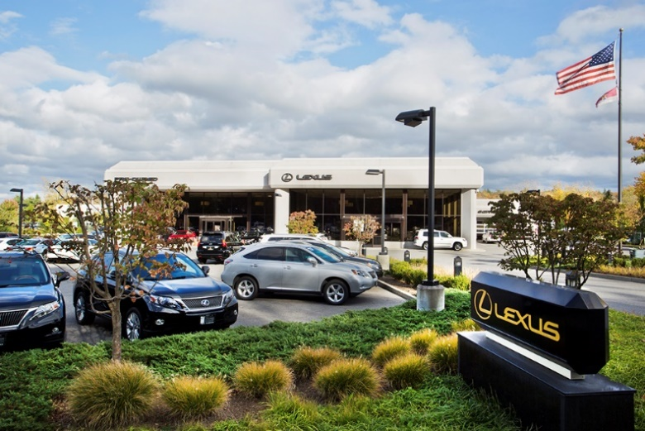
1 STONE PLACE | BRONXVILLE, NY
(AKA 30 MILBURN STREET)
MOUNT KISCO, NY
MOUNT KISCO, NY
101 S. Beford Road
MOUNT KISCO, NY | A Retail Hot Spot
MOUNT KISCO - THE “COMMERCIAL HUB”
With its location situated in the center of northern Westchester County, Mount Kisco is often referred to as "the commercial hub" of northern Westchester. In addition to the many downtown retail options, there is a plethora of big box stores and high-end automobile sales dealerships along the North Bedford Road/Rte 117 retail corridor, which lies across the popular Mount Kisco / Bedford Hills border. The entire retail strip spans a commercially dense four (4) miles.
This massive retail hub is only a half (0.5) mile from downtown Mount Kisco. Shoppers from near and far enjoy an array of retailers, restaurants and services such as Target, Stop & Shop, Kohl’s, Staples, Petco, Restore, Sherwin Wiliams, FedEx, CVS, Five Guys Burgers & Fries, BMW, Lexus, Land Rover, and Tesla. This well-known thoroughfare also includes popular fitness and entertainment options for the entire family including the Saw Mill River Club East, New York Grand Prix Racing, SkyZone Trampoline Park, Sparklicious and Dogtopia of Mount Kisco.
Notes:
Summary of 2005 Demographics
1-Mile Radius
3-Mile Radius
5-Mile Radius
Average Household Income
$164,268
$137,088
$108,570
Median Household Income
$103,702
$97,128
$78,859
Population
15,630
109,659
349,829
Total Households
6,025
39,567
130,273
Pop. Density (per Sq. Mi.)
4,975
3,878
4,454
Summary of 2005 Demographics
1-Mile Radius
3-Mile Radius
5-Mile Radius
Average Household Income
$164,268
$137,088
$108,570
Median Household Income
$103,702
$97,128
$78,859
Population
15,630
109,659
349,829
Total Households
6,025
39,567
130,273
Pop. Density (per Sq. Mi.)
4,975
3,878
4,454

Slide 14
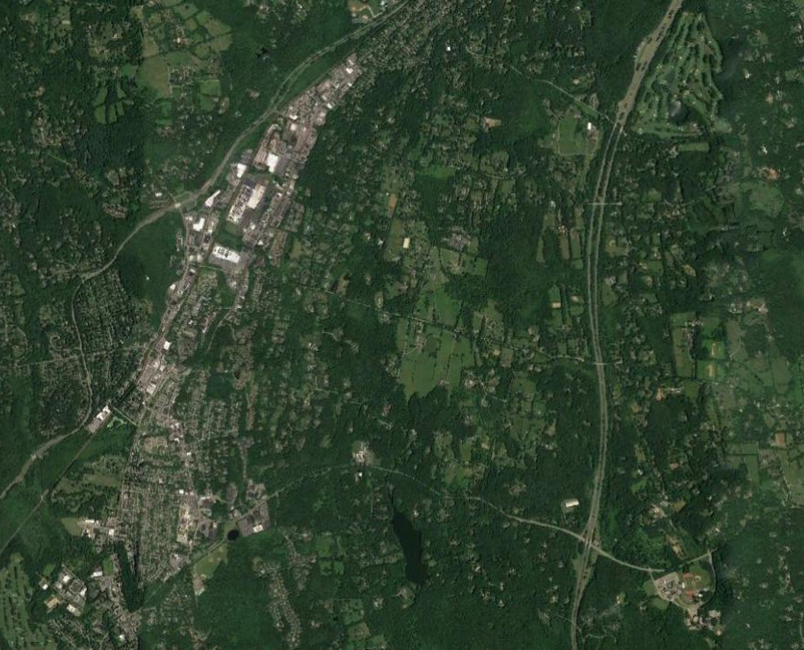



REGIONAL AERIAL
MOUNT KISCO, NY
101 S. Beford Road
Greater
Mount Kisco/
Bedford Hills Region
YORKTOWN HEIGHTS
BEDFORD HILLS
AND KATOHAH
CROSS RIVER
REGIONAL RETAIL CORRIDOR
( N Bedford Rd/Rte 117)
SAW MILL RIVER PARKWAY
BEDFORD AND
POUND RIDGE
I-684
METRO-NORTH TRAIN (HARLEM LINE)
DOWNTOWN
MOUNT KISCO
CONTACT OWNER’S EXCLUSIVE AGENTS:
ALEC FREDERICO
Licensed Real Estate Salespersons
914-779-8200 x 118
alec@admiralrealestate.com
SITE
CB2
NORTHERN
WESTCHESTER
HOSPITAL
CHAPPAQUA AND
PLEASANTVILLE

